Slide 1
Final Exam Review

Slide 2

The manager of a restaurant found that the cost to produce 100 cups of coffee is $11.12 , while the cost to produce 500 cups is $50.32. The restaurant sells sells each cup of coffee for $1.50. a. Find a formula for the linear cost function, C(x). b. How many cups must be sold to break even? c. How many cups of coffee must be sold to make a profit of $500?
Use the points (100, 11.12) and (500, 50.32) to determine the slope.
$$m=\frac{50.32−11.12}{500−100}=0.098$$
C(x) = 0.098x + b.
To determine b, use either point and solve for b.
11.12 = 0.098(100) + b
b = 1.32
The cost function is C(x) = 0.098x + 1.32

Slide 3

The manager of a restaurant found that the cost to produce 100 cups of coffee is $11.12 , while the cost to produce 500 cups is $50.32. The restaurant sells sells each cup of coffee for $1.50. a. Find a formula for the linear cost function, C(x). b. How many cups must be sold to break even? c. How many cups of coffee must be sold to make a profit of $500?
Since C(x) = 0.098x + 1.32 and R(x) = 1.5x, set these equal to each other and solve for x.
1.5x = 0.098x + 1.32
x $≈$ 0.942
The restaurant will break even at x = 1, or 1 cup of coffee.

Slide 4
The manager of a restaurant found that the cost to produce 100 cups of coffee is $11.12 , while the cost to produce 500 cups is $50.32. The restaurant sells sells each cup of coffee for $1.50. a. Find a formula for the linear cost function, C(x). b. How many cups must be sold to break even? c. How many cups of coffee must be sold to make a profit of $500?
To determine how many must be sold to make $500 profit, we first determine the profit function.
P(x) = R(x) - C(x) = 1.5x – (0.098x + 1.32) = 1.402x – 1.32.
Now set P(x) = 500 and solve for x.
1.402x – 1.32 = 500
x = 357.57
The restaurant needs to sell 358 cups of coffee to make $500 profit.

Slide 5
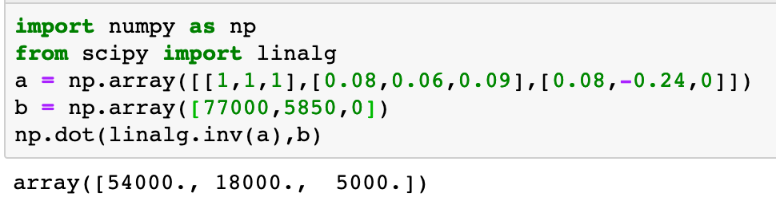
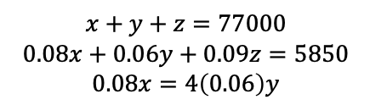
An investment of $77,000 was made by a business club. The investment was split into three parts and lasted for one year.
The first part of the investment earned 8% interest, the second 6%, and the third 9%. Total interest from the investments was $5,850. The interest from the first investment was 4 times the interest from the second. Find the amounts of the three parts of the investment.
Let x = the amount in the 1st investment, y = the amount in the 2nd investment, and z = the amount in the 3rd investment.
$$x+y+z=77000$$
$$0.08x+0.06y+0.09z=5850$$
$$0.08x=4\left(0.06\right)y$$

Slide 6
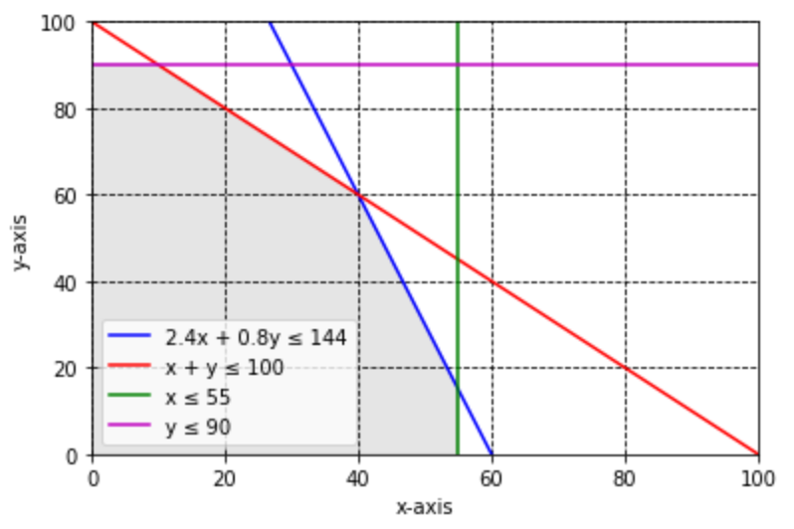
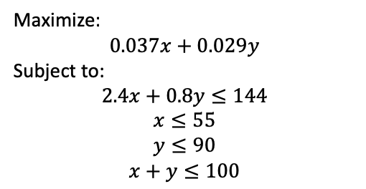
A dairy company gets milk from two dairies and then blends the milk to get the desired amount of butterfat. Milk from dairy I costs $2.40 per gallon, and milk from dairy II costs $0.80 per gallon. At most $144 is available for purchasing milk. Dairy I can supply at most 55 gallons averaging 3.7% butterfat, and dairy II can supply at most 90 gallons averaging 2.9% butterfat. How much milk from each supplier should the company buy to get at most 100 gallons of milk with the maximum amount of butterfat? What is the maximum amount of butterfat?
Let x = the # of gallons from dairy I and y = the # of gallons from dairy II.
Maximize:
$$0.037x+0.029y$$
Subject to:
$$2.4x+0.8y≤144$$
$$x≤55$$
$$y≤90$$
$$x+y≤100$$
Corner points of feasible region:
(0, 0), (0, 90), (10, 90), (40, 60), (55, 15), (55, 0)
(40, 60) produces the maximum amount of butterfat.
The amount of butterfat is 3.22 gallons.

Slide 7
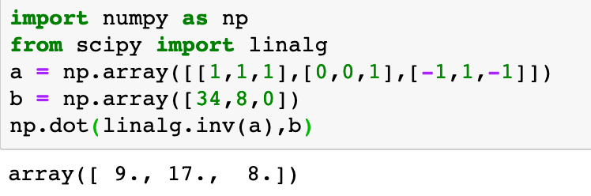
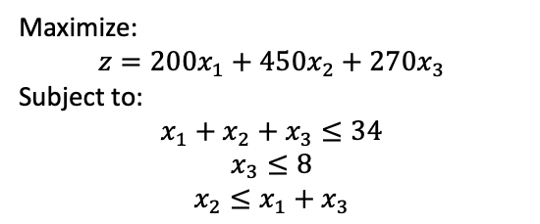
As part of a weight reduction program, a man designs a monthly exercise program consisting of bicycling, jogging, and swimming. He would like to exercise at most 34 hours, devote at most 8 hours to swimming, and jog for no more than the total number of hours bicycling and swimming. The calories burned by this person per hour by bicycling, jogging, and swimming are 200, 450, and 270, respectively. How many hours should be allotted to each activity to maximize the number of calories burned? What is the maximum number of calories he will burn?
Let x₁ = # of hours spent cycling, x₂ = # of hours spent jogging, and x₃ = # of hours spent swimming.
Maximize:
$$z=200x_{1}+450x_{2}+270x_{3}$$
Subject to:
$$x_{1}+x_{2}+x_{3}≤34$$
$$x_{3}≤8$$
$$x_{2}≤x_{1}+x_{3}$$

Slide 8
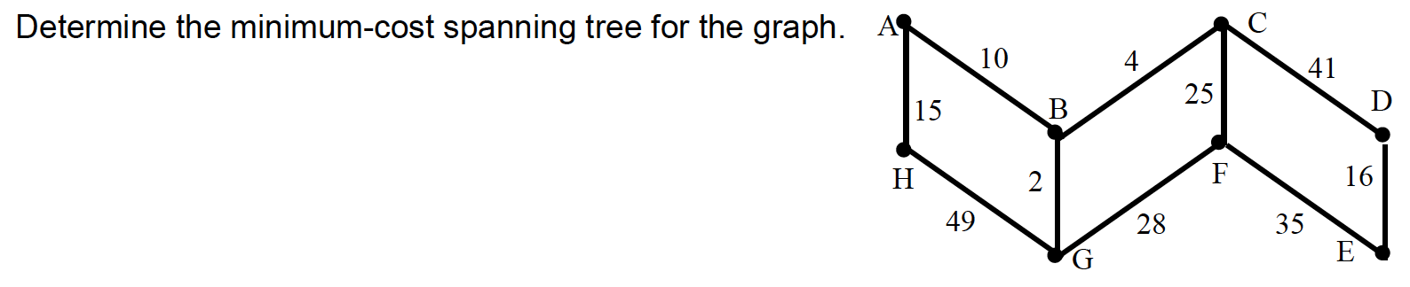
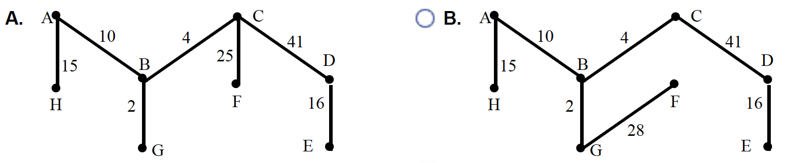
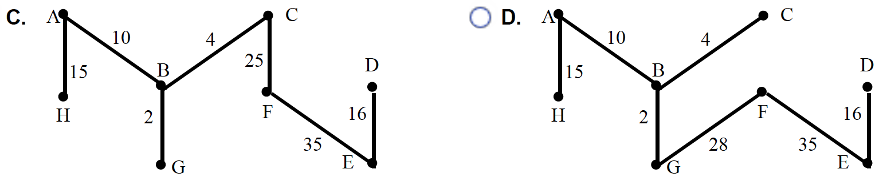
Kruskal’s Algorithm
B, G – 2
B, C – 4
A, B – 10
A, H – 15
D, E – 16
C, F – 25
F, G – 28
E, F – 35
C, D – 41
G, H – 49
Can eliminate option A
Can eliminate options B & D
F, G creates a circuit

Slide 9



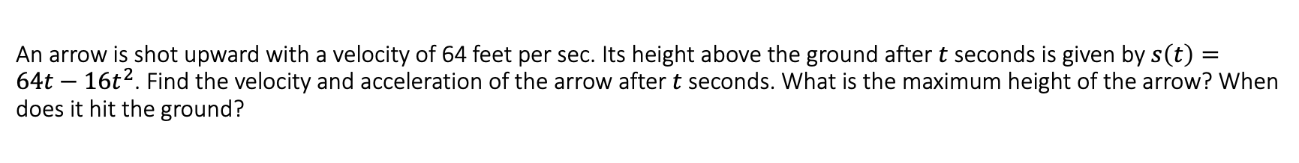

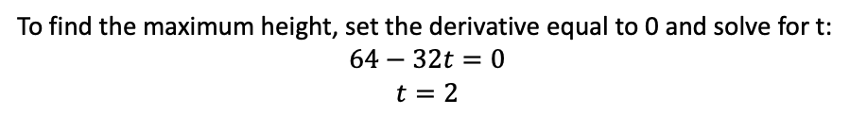

An arrow is shot upward with a velocity of 64 feet per sec. Its height above the ground after $t$ seconds is given by $s\left(t\right)=64t−16t^{2}$. Find the velocity and acceleration of the arrow after $t$ seconds. What is the maximum height of the arrow? When does it hit the ground?
$$v\left(t\right)=s^{′}\left(t\right)=64−32t$$
$$a\left(t\right)=−32$$
To find the maximum height, set the derivative equal to 0 and solve for t:
$$64−32t=0$$
$$t=2$$
The arrow reaches a maximum height after 2 seconds.
The maximum height is:
$s\left(2\right)=64\left(2\right)−16\left(4\right)=64$ feet
The arrow hits the ground when $s\left(t\right)=0$
$$64t−16t^{2}=0$$
$$16t\left(4−t\right)=0$$
$$t=0, 4$$
The arrow hits the ground after 4 seconds.

Slide 10
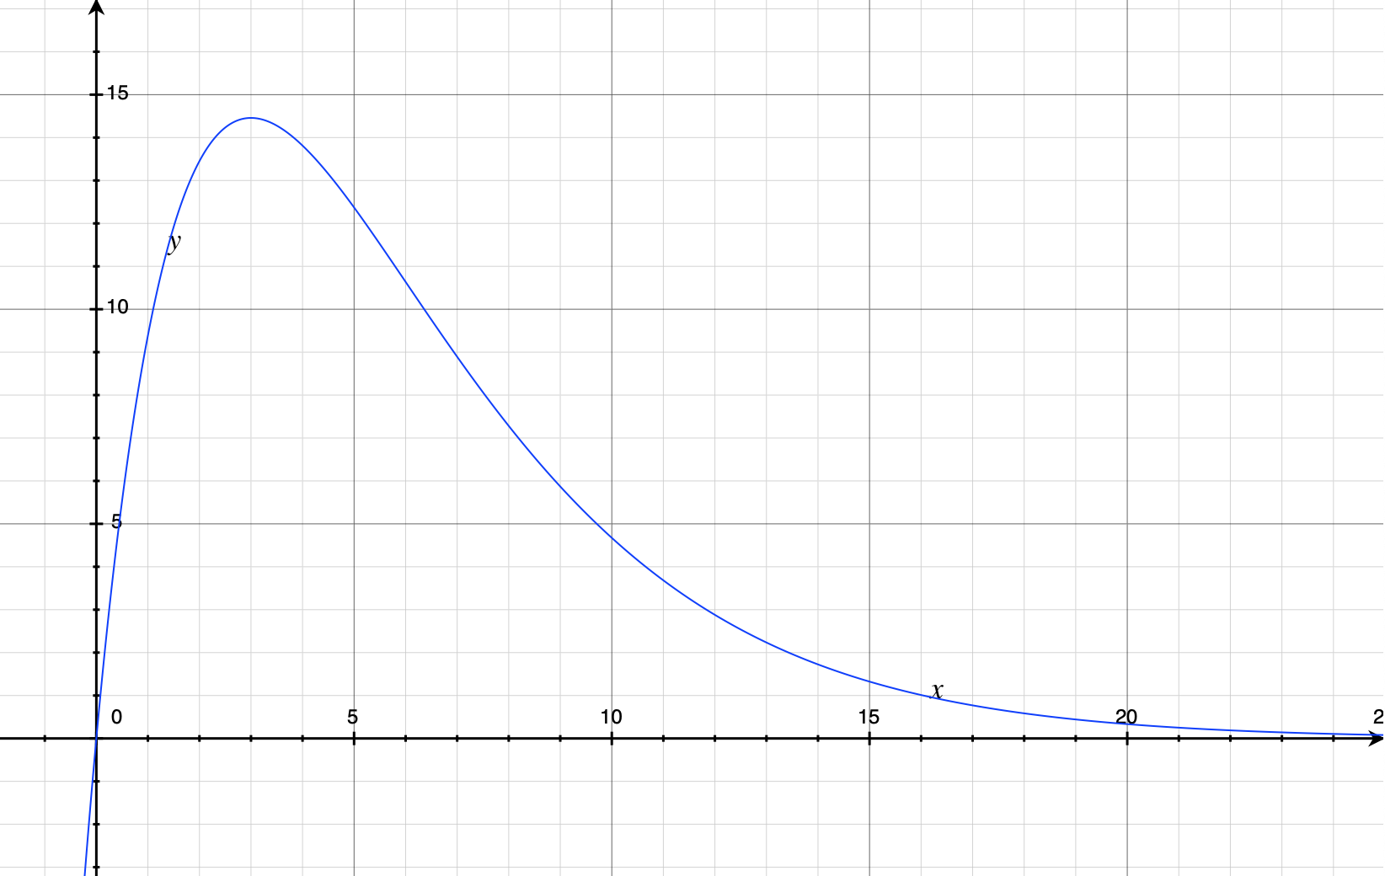
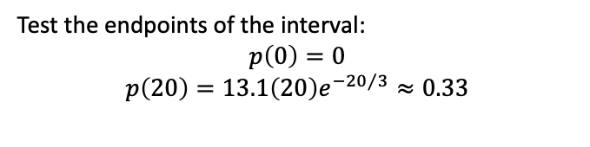

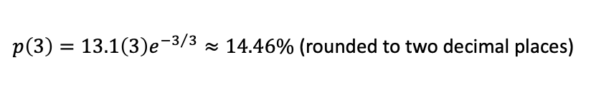
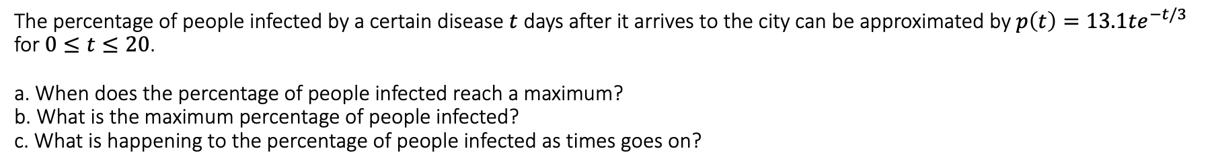

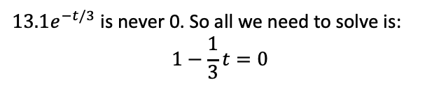
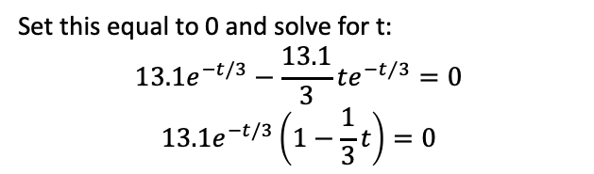
The percentage of people infected by a certain disease $t$ days after it arrives to the city can be approximated by $p\left(t\right)=13.1te^{−t/3}$ for $0≤t≤20$. a. When does the percentage of people infected reach a maximum? b. What is the maximum percentage of people infected? c. What is happening to the percentage of people infected as times goes on?
$$p^{′}\left(t\right)=13.1e^{−t/3}−\frac{13.1}{3}te^{−t/3}$$
$p\left(3\right)=13.1\left(3\right)e^{{−3}/3}≈14.46\%$ (rounded to two decimal places)
Set this equal to 0 and solve for t:
$$13.1e^{−t/3}−\frac{13.1}{3}te^{−t/3}=0$$
$$13.1e^{−t/3}\left(1−\frac{1}{3}t\right)=0$$
Test the endpoints of the interval:
$$p\left(0\right)=0$$
$$p\left(20\right)=13.1\left(20\right)e^{{−20}/3}≈0.33$$
Thus, the maximum percentage of people infected is 14.46%.
$13.1e^{−t/3}$ is never 0. So all we need to solve is:
$$1−\frac{1}{3}t=0$$
Graph the function to determine its pattern.
$t=3$, so the percentage of people infected reaches a maximum after 3 days.
The function begins by increasing then it decreases.

Slide 11
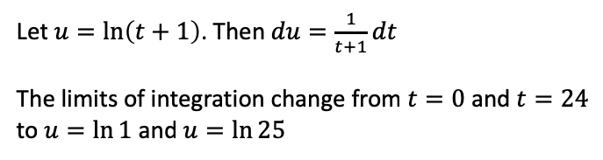
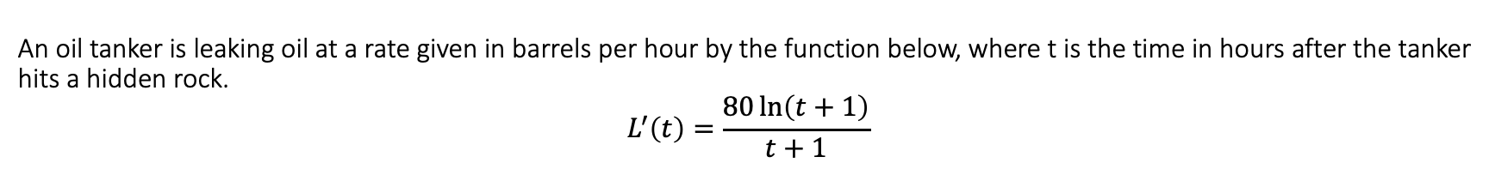
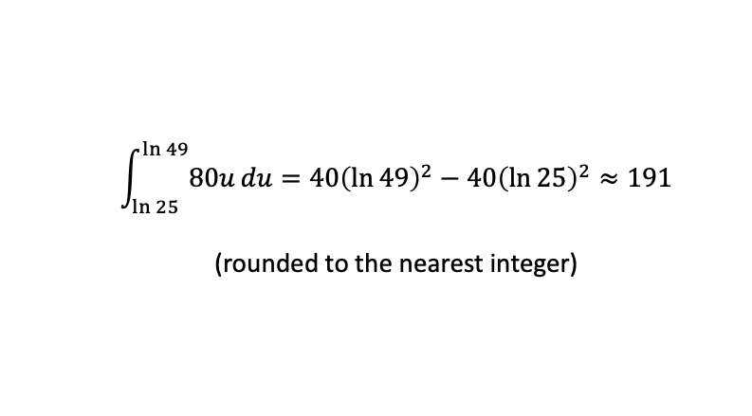
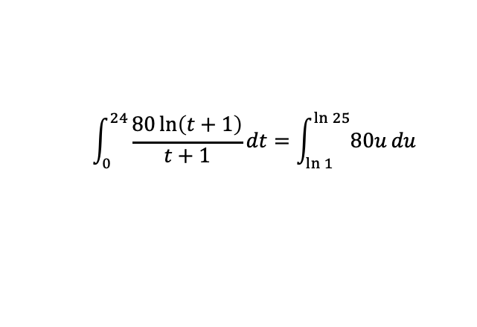
An oil tanker is leaking oil at a rate given in barrels per hour by the function below, where t is the time in hours after the tanker hits a hidden rock.
$$L^{′}\left(t\right)=\frac{80\ln\left(t+1\right)}{t+1}$$
Find the total number of barrels the tanker will leak during the first day.
Caution: Check the units – time in L’(t) is given in hours.
Thus, we have to integrate from 0 to 24.
Find the total number of barrels the tanker will leak during the 2nd day.
Let $u=\ln\left(t+1\right)$. Then $du=\frac{1}{t+1}dt$
The limits of integration change from $t=0$ and $t=24$ to $u=\ln{1}$ and $u=\ln{25}$
$$\int_{\ln{25}}^{\ln{49}}{80u}du=40{\left(\ln{49}\right)}^{2}−40{\left(\ln{25}\right)}^{2}≈191$$
(rounded to the nearest integer)
$$\int_{0}^{24}{\frac{80\ln\left(t+1\right)}{t+1}dt}=\int_{\ln{1}}^{\ln{25}}{80u}du$$
$=40{\left(\ln{25}\right)}^{2}−40{\left(\ln{1}\right)}^{2}≈414$ (rounded to the nearest integer)

Slide 12
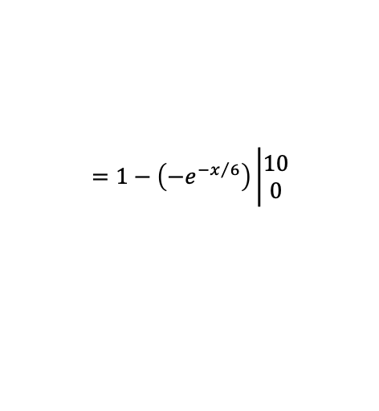

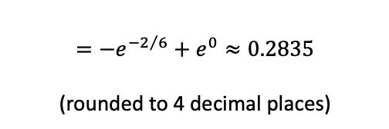
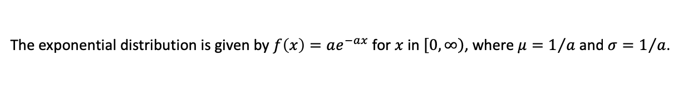
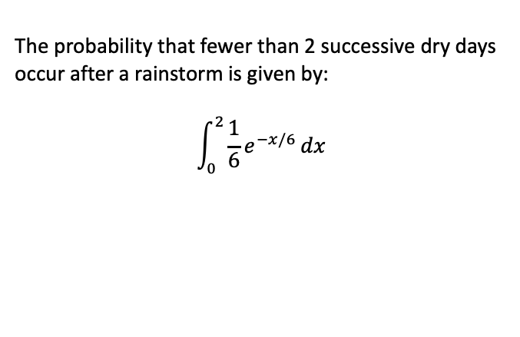
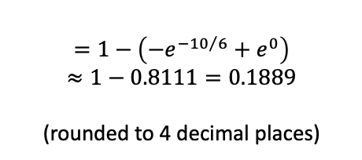
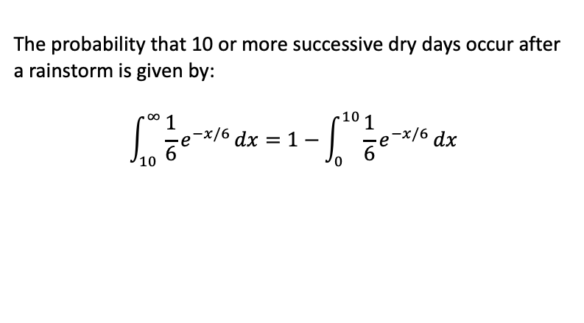
Researchers have shown that the number of successive dry days that occur after a rainstorm for a particular region is a random variable that is exponentially distributed with a = 1/6. What is the probability that 10 or more successive dry days occur after a rainstorm? What is the probability that fewer than 2 successive dry days occur after a rainstorm?
The exponential distribution is given by $f\left(x\right)=ae^{−ax}$ for $x$ in $\left[\left.0,∞\right)\right.$, where $μ=1/a$ and $σ=1/a$.
Thus, $f\left(x\right)=\frac{1}{6}e^{−x/6}$ in our case.
The probability that 10 or more successive dry days occur after a rainstorm is given by:
$$\int_{10}^{∞}{\frac{1}{6}e^{−x/6}}dx=1−\int_{0}^{10}{\frac{1}{6}e^{−x/6}}dx$$
The probability that fewer than 2 successive dry days occur after a rainstorm is given by:
$$\int_{0}^{2}{\frac{1}{6}e^{−x/6}}dx$$
$$=1−\left(−e^{{−x}/6}\right)\left|\begin{matrix}10 \\ 0\end{matrix}\right.$$
$$=−e^{{−2}/6}+e^{0}≈0.2835$$
(rounded to 4 decimal places)
$$=1−\left(−e^{{−10}/6}+e^{0}\right)$$
$$≈1−0.8111=0.1889$$
(rounded to 4 decimal places)

